Slide 1
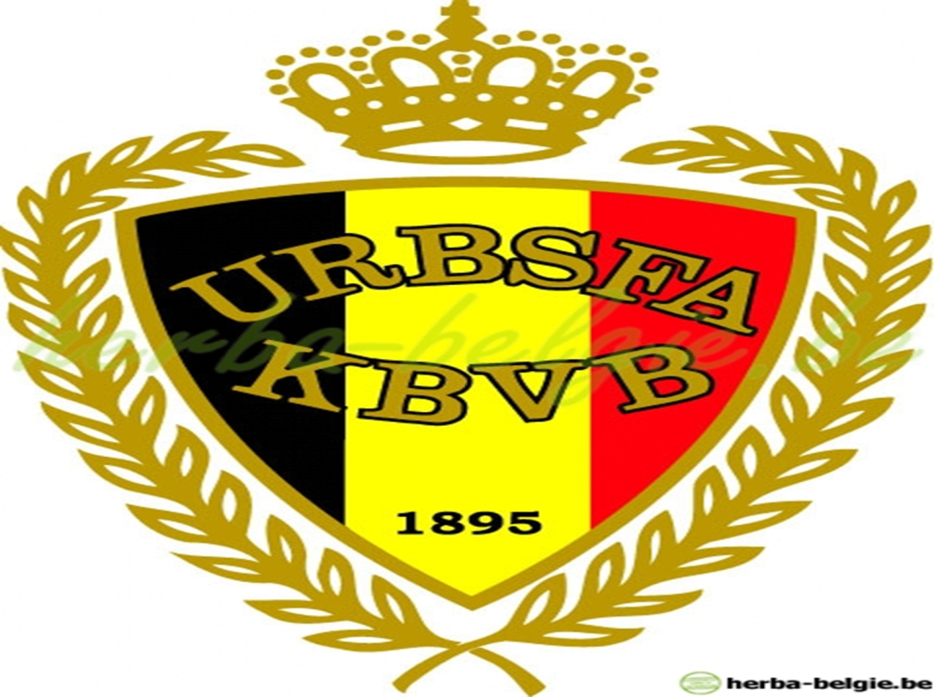
Belgian Royal association

Slide 2
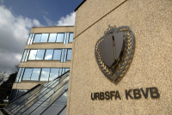
Arise Belgian football
The Belgian Football Association was founded on September 1st, 1895

Slide 3
Most used selection

Slide 4
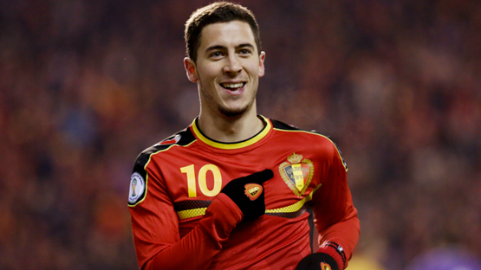
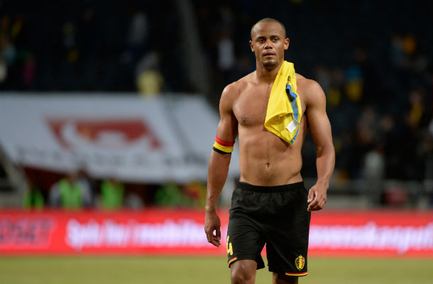
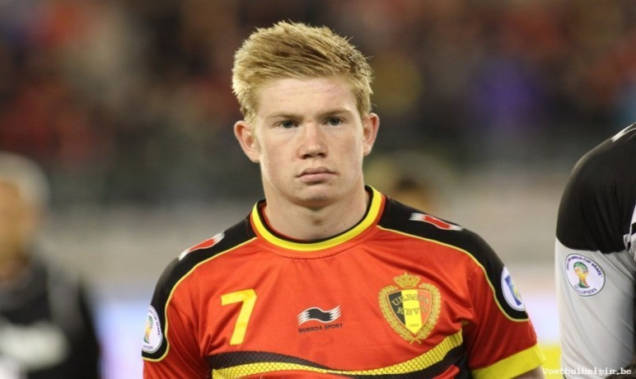
Famous Belgian players
Eden Hazard
(Chelsea)
Vincent Kompany
(Manchester city)
Kevin De Bruyne
(Wolfsburg)

Slide 5
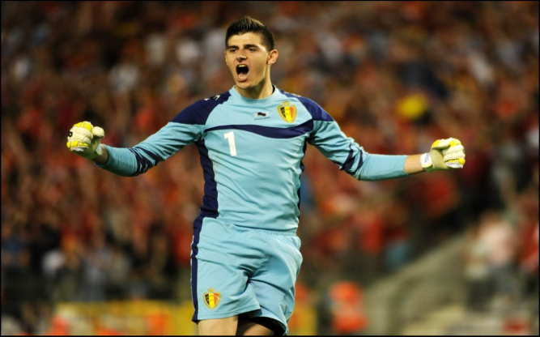
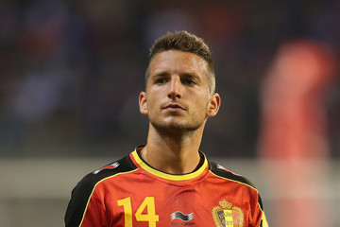
Famous Belgian players
Thibault Courtois
(Chelsea)
Dries Mertens
(Napoli)

Slide 6
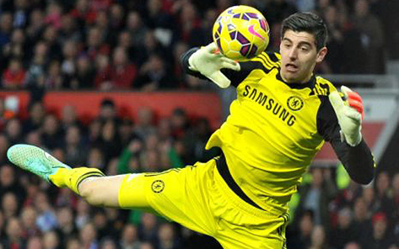
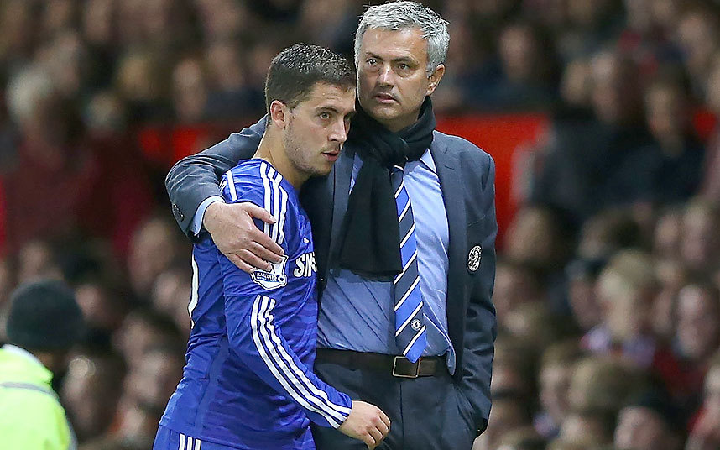
Belgian players that are nominated for Ballon d’or 2014
Thibault Courtois
Eden Hazard

Slide 7
Cyclocross

Slide 8
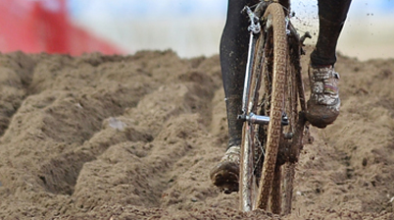
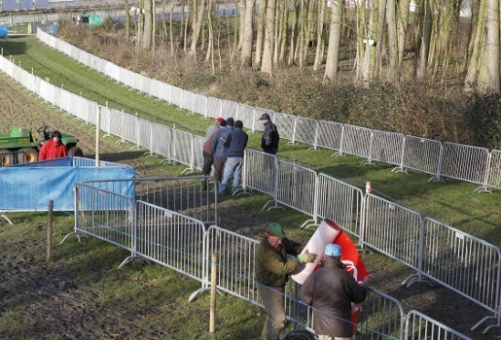
Parts of a cross
Sand
Grass

Slide 9
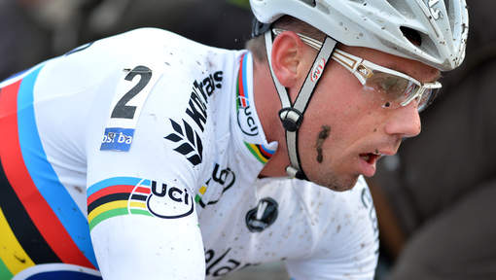
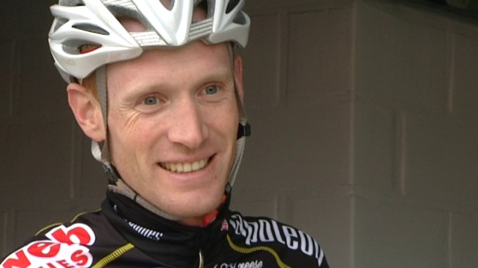
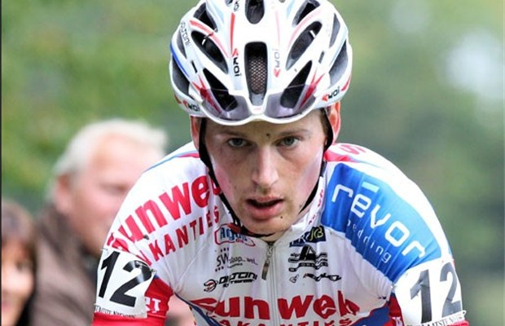
Famous cyclists
Sven Nys
Kevin Pauwels
Klaas Vantornhout (Belgian champion)

Slide 10
Cycling

Slide 11
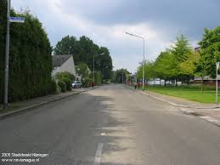
Parts of cycling
Street

Slide 12
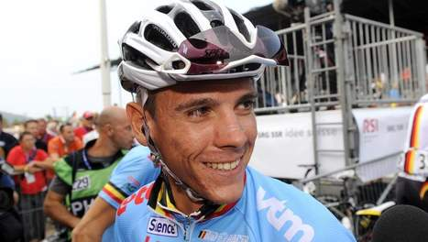
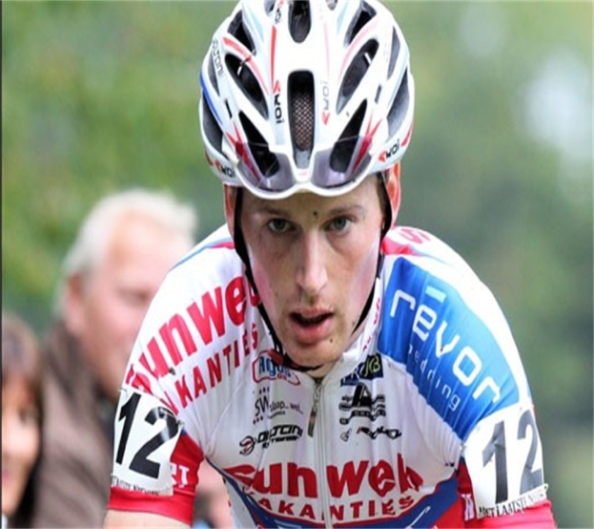
Famous cyclists
Philippe Gilbert
Kevin Pauwels

Slide 13
Famous belgian tours
Kuurne-Brussels-Kuurne
Round of Flanders
Round of Belgium
Round of Wallonia
Championship of Flanders

